Slide 1
Introductory General Chemistry
Chemistry 3A
S. M. Halloran

Slide 2
Word Equations
Chemical Equations
Balancing Equations
Predicting Reactions: Single & Double Displacement Reactions
Writing Chemical Equations for Reactions in Solution
Complete Chemical Equations
Complete Ionic Equations
Net Ionic Equations
Oxidation/Reduction
How to understand them and to apply them

Slide 3
Chemical Reactions & Conservation Laws
Chemical reactions are expressed in a way just as mathematics uses equations: to show something is connected at a time before with something that comes after
A reaction is an expression of substances that react—the reactants—and the result of the reaction—the products
Reactants → Products
The expression of these is about the conservation laws of mass (matter), energy, and electric charge

Slide 4
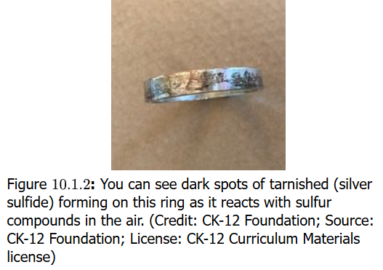
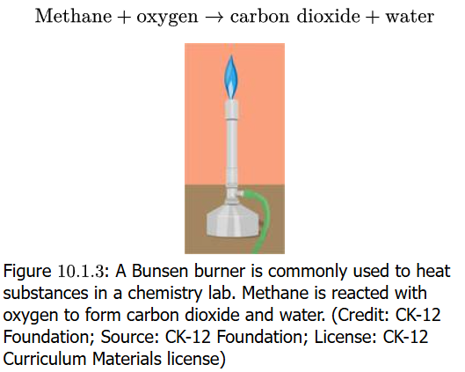
Equations in Words
Chemical reactions are expressed essentially as equations, and the expression can be in words
Silver metal solid is reacted with sulfur with the result it forms silver sulfide
If you have ever seen tarnish on silver metal set, you see silver sulfur compound
When natural gas (methane) is burned in a Bunsen burner, the gas reacts with oxygen (O₂) in the air to produce carbon dioxide (CO₂) and water (H₂O)
A problem with equations as words is that they can not indicate the quantitative nature of reactions
See also https://youtu.be/vTq4sgGd2QU

Slide 5
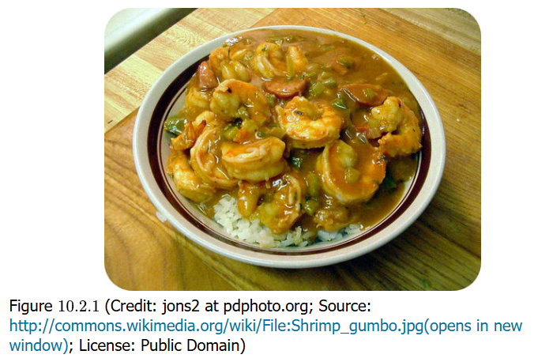
Steps in Chemistry = Recipe
Yum! Yum!
Your book wants to point out that steps in laboratory work such as a chemical synthesis align with a metaphor of making a delicious preparation of shrimp gumbo
Chemists are probably good in the kitchen as well because they must carefully, meticulously gather the ingredients and then “cook” them in the correct way to get an exacting result

Slide 6
Chemical Equations
Chemical equations start with using chemical formula which express matter as the symbols of the elements of the Periodic Table
The reactants and products as compounds are a sketch of the reaction. This is the skeleton equation
CH₄ + O₂ → CO₂ + H₂O
The next step is to indicate the physical state of the compounds:
CH₄ (g) + O₂ (g) → CO₂ (g) + H₂O (l)
(s) = solid, (l) = liquid, (g) = gas, (aq) = compound in aqueous phase

Slide 7
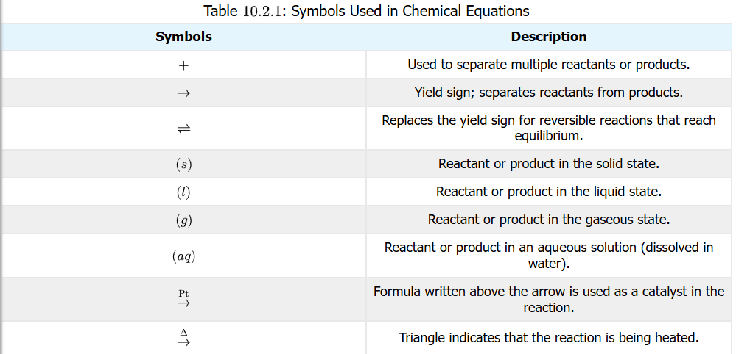
Symbols in Chemical Equations
It is important to understand the symbols used in chemical reaction equations
See also https://youtu.be/ZcF8E8aAOGs

Slide 8
Balancing Equations
With the skeleton equation up on the whiteboard, it is time to apply the laws of the conservation of mass (electric charge & energy can be examined later)
One of the most important beginnings in chemistry is writing reactions (equations) that show the formation of compounds from their elemental forms
practice exercises calculating the enthalpy of formation is often seen with this
The elemental form of carbon is C (s). The elemental form of hydrogen is H₂ (g)
From these two, the formation of methane CH₄ (g) is shown
C (s) + H₂ (g) → CH₄ (g)
The equation is missing mass balance however, which it must have on both sides of the reaction arrow
There is one atom of C on both sides, so that’s OK, but there are 2 atoms of H on left side, but 4 atoms on the right. The left needs 2 more atoms, which can be done by doing the following:
C (s) + 2 H₂ (g) → CH₄ (g)

Slide 9
Details of Balancing Equations
In the previous slide, a 2 was added to the H₂ (g) reactant to achieve the balance of atoms on both sides of the reaction arrow
C (s) + 2 H₂ (g) → CH₄ (g)
This 2 and any whole number/integer placed in front of a chemical compound in a chemical equation is called a coefficient
This is also term in mathematics for a number placed in front of a variable in an algebraic expression
Putting a coefficient in front of a compound has the effect of multiplying the number of each atom in the compound by the number of the coefficient, and if the atom is subscripted, by that subscript number too
2 H₂ = 2 x 2 H = 4 H atoms 2 CO₂ = 2 x 1 C = 2 C atoms; 2 x 2 O = 4 O atoms 4 H₂O = 4 x 2 H = 8 H atoms; 4 x 1 O = 4 O atoms 3 MnO₄ = 3 x 1 Mn = 3 Mn atoms; 3 x 4 O = 12 O atoms

Slide 10
Steps To Balancing Equations
Set up the skeleton equation: write down the correct chemical formulas on each side of the reaction arrow, the reactants and products
Identify all atoms and count the number of atoms on the reactant and product side
If polyatomic ions are unchanged on both sides, count it as a unit
Begin the balancing by focusing on elements that occur in only one compound on one side
For instance, oxygen often in appears in more than one compound on one side the arrow: do not start with balancing oxygen atoms
Balancing can ONLY be done by using coefficients: changing subscripts changes the chemical nature of a compound, and this is not permitted
When satisfied of completion, verify the numbers of atoms on both sides of reaction arrow
Make sure coefficients have lowest possible ratio, while remaining integers

Slide 11
Practice Balancing Equations
Set up the skeleton equation: write down the correct chemical formulas on each side of the reaction arrow, the reactants and products
Identify all atoms and count the number of atoms on the reactant and product side
If polyatomic ions are unchanged on both sides, count it as a unit
Begin the balancing by focusing on elements that occur in only one compound on one side
For instance, oxygen often in appears in more than one compound on one side the arrow: do not start with balancing oxygen atoms
Balancing can ONLY be done by using coefficients: changing subscripts changes the chemical nature of a compound, and this is not permitted
When satisfied of completion, verify the numbers of atoms on both sides of reaction arrow
Make sure coefficients have lowest possible ratio, while remaining integers

Slide 12
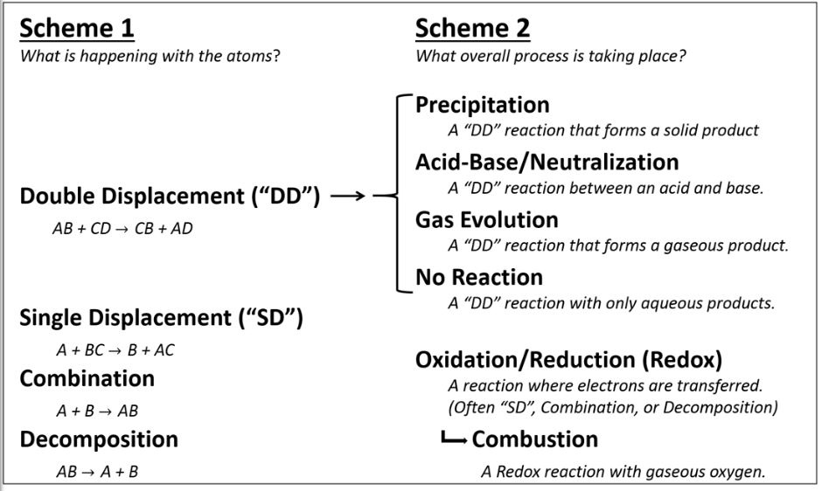
Types of Reactions
Chemical reactions will fall under certain types/categories on one level, and then on an additional level with question “what is happening with atoms?”
On an additional level, the question is “what process is happening?”
You will learn to identify these types or categories of reactions

Slide 13
Combination Reactions
A + B → AB
This reaction type is about synthesis: two substances combine to form a single (third) compound
Sodium metal solid reacts with chlorine gas to form the solid sodium chloride
2 Na (s) + Cl₂ (g) → 2 NaCl (s)

Slide 14
Oxide Formation: A Combination Reaction
Oxygen O₂ in the air reacting with numerous elements is perhaps one of the most important significant of reactions
2 Mg (s) + O₂ (g) → 2 MgO (s)
This reaction was one of your recent lab experiments!!
S (s) + O₂ (g) → SO₂ (g)
2 S (s) + 3 O₂ (g) → 2 SO₃ (g)
2 Fe (s) + O₂ (g) → 2 FeO (s)
4 Fe (s) + 3 O₂ (g) → 2 Fe₂O₃ (s)
4 K (s) + O₂ (g) → 2 K₂O (s)

Slide 15
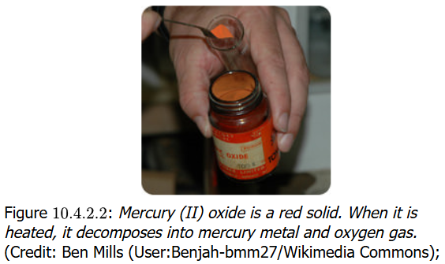
Decomposition Reactions
AB → A + B
The decomposition reaction type appears to be the very opposite of the combination reaction
One substance (shown as “parts” of A and B) is “decomposed” to form two or more substances/compounds
Many of these reactions require an input of energy— an “activation energy”— for the reaction to proceed
2 HgO (s) → 2 Hg (l) + O₂ (g)
A compound decomposes to elements in this reaction

Slide 16
Decomposition Reactions
Decomposition reaction include compounds decomposing to compounds:
CaCO₃ (s) → CaO (s) + CO₂ (g)
Here metal oxides are formed from their hydroxides
2 NaOH (s) → Na₂O (s) + H₂O (l)
Acids like the unstable carbonic acid will decompose quickly to nonmetal oxides and water
H₂CO₃ (aq) → CO₂ (g) + H₂O (l)
Potassium chlorate is a well-known decomposition reaction
2 KClO₃ (s) → 2 KCl (s) + H₂O (l)
The electrolysis of water is a well-known decomposition
H₂O (l) → H₂ (g) + O₂ (g)

Slide 17
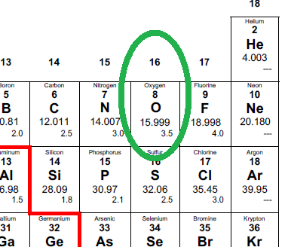
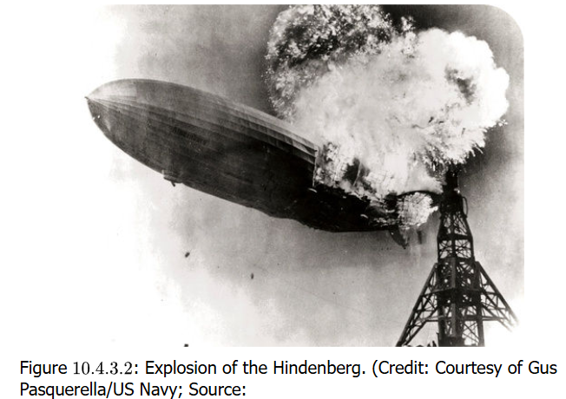
Combustion Reactions
X + O₂ (g) → XO_{n} + …
Combustion reactions always involve gaseous oxygen (O₂) as a reactant
Humans learned the hard way with the Hindenberg airship disaster that hydrogen gas (H₂) also gets combusted
2 H₂ (g) + O₂ (g) ➔ 2 H₂O (g)
Are you a gas griller? Here is the combustion of propane:
C₃H₈ (g) + 5 O₂ (g) → 3 CO₂ (g) + 4 H₂O (g)
Among the many important things to learn in chemistry, one of these is just how much oxygen is involved in much of chemistry

Slide 18
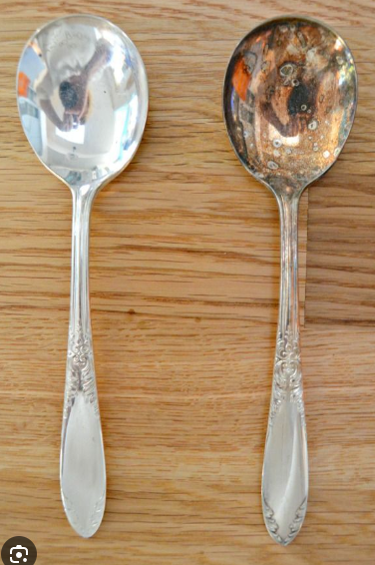
Single Replacement Reactions
Silver tarnishes. The metal reacts with hydrogen sulfide (H₂S) which is always present in small amounts in the air
2 Ag (s) + H₂S (g) → Ag₂S (s) + H₂ (g)
This is an example of a single-replacement reaction
A + BC → AC + B
One (usually metal) element A replaces a similar (also metal) element B in a compound
If A is a nonmetal, it will replace the nonmetal that is B with C

Slide 19
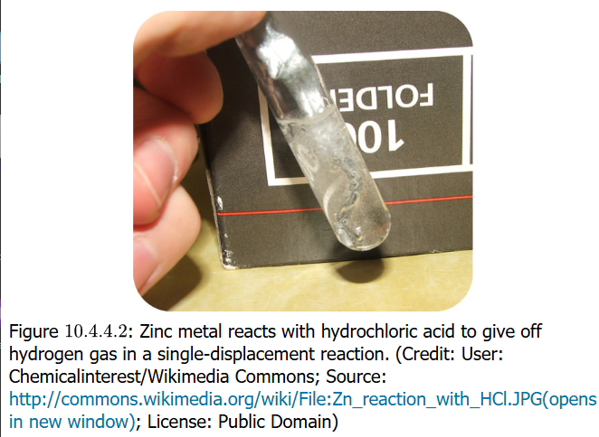
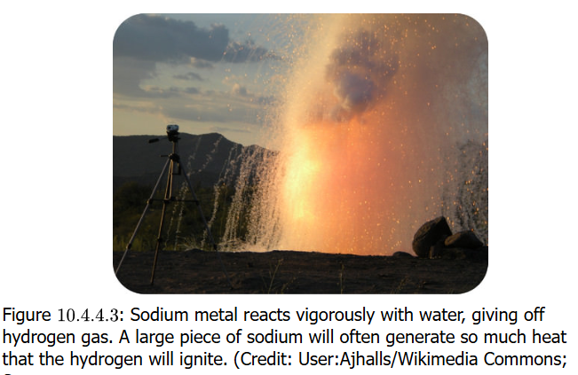
Single Replacement Reactions
Metal Replacement
Mg (s) + Cu(NO₃)₂ (aq) → Mg(NO₃)₂ (aq) + Cu (s)
Mg more reactive than Cu and replaces it
Hydrogen Replacement
Zn (s) + 2 HCl (aq) → ZnCl₂ (aq) + H₂ (g)
Acidic proton is replaced by active metal
Water is not usually considered an acid, but some metals are so reactive that they replace the H in H₂O to form the metal hydroxide
2 Na (s) + 2 H₂O (l) → 2 NaOH (aq) + H₂ (g)

Slide 20
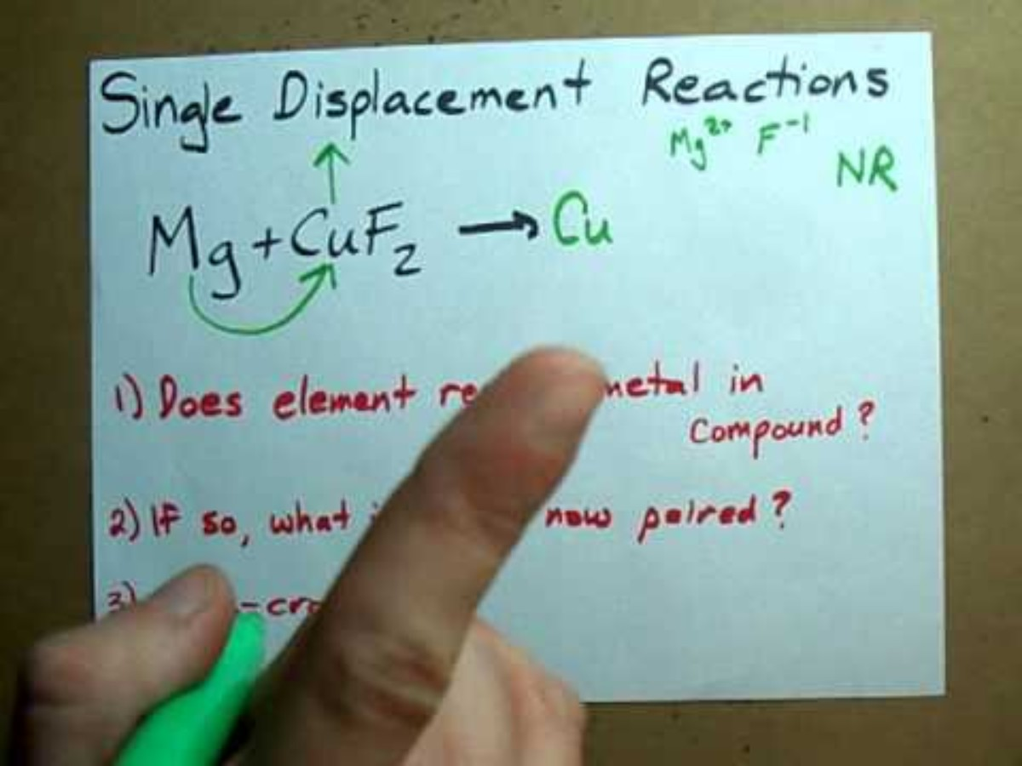
Single Replacement Reactions
Halogen Replacement
The interesting thing about this reaction is that diatomic chlorine molecule replaces bromine ion to produce chloride ion and diatomic bromine molecule (it actually takes electrons away from Br in an oxidation reaction)
Cl₂ (g) + 2 NaBr (aq) → 2 NaCl (aq) + Br₂ (l)
Cl₂ will do the same to NaI.
Fluorine (F₂) will do the same to NaCl or NaBr or NaI.
And Br₂ will do the same to NaI. All these elements are in same Group (column), and they show a reactivity based on the period (row) they are in
Reactivity decreases with increasing period

Slide 21
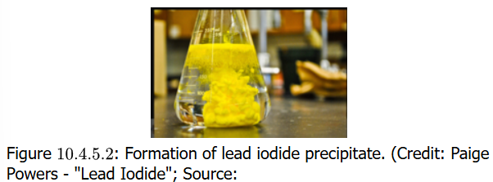
Double Replacement Reactions
AB + CD → AD + CB
This reaction is when the cations and anions of two ionic compounds exchange places to form two different ionic compounds
A & C are the cations, B and D are the anions
These reactions happen when one of the products is a precipitate, gas or a molecule like H₂O
Precipitate
2 KI (aq) + Pb(NO₃)₂ (aq) → 2 KNO₃ (aq) + PbI₂ (s)
Pb²⁺ and I⁻ ions strongly bind and form a solid

Slide 22
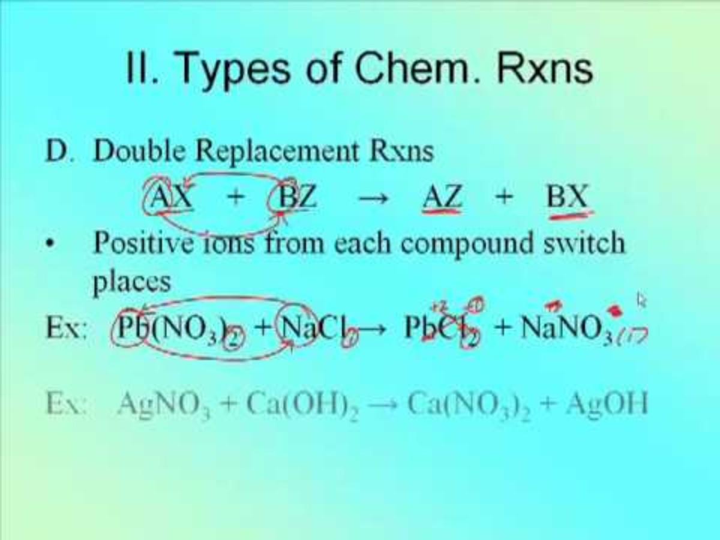
Double Replacement Reactions
Gas Formation
Na₂S (aq) + 2 HCl (aq) → 2 NaCl (aq) + H₂S (g)
The H₂S gas bubbling out actually drives the action further to the right, promoting the reaction
Molecular Compound Formation
HCl (aq) + NaOH (aq) → NaCl (aq) + H₂O (l)
This is actually a classic reaction of a strong acid with a strong base to produce a salt and water

Slide 23
Predicting Single Displacement Reactions
The hydrogen and halogen single replacement reactions were discussed a couple of slides back
For ionic compounds, elements of the same type will replace elements of that type
Metal cations/elements replace metal cations
Nonmetal anions/elements replace nonmetal anions
FeCl₂ + Ca → ?
CaCl₂ + Fe
CaBr₂ + F₂ → ?
CaF₂ + Br₂
FeI₂ + Cl₂ → ?
FeCl₂ + I₂
AlPO₄ + Mg → ?
Mg₃(PO₄)₂ + Al

Slide 24
Predicting Double Displacement Reactions
There are patterns and trends that can be seen with these reactions making them predictable
Exchange anions and cations on reactant side to form new product compounds
Since charge magnitude may differ on cations or anions (1+ and 2+, or 1– and 2–) between reactants and products, formulas may need to be corrected (remember the criss-cross method)
Balance the equation
Consider barium chloride (BaCl₂) and lithium sulfate (Li₂SO₄) next

Slide 25
Predicting Double Displacement Reactions
Exchange anions and cations on reactant side to form new product compounds
BaCl₂ (aq) + Li₂SO₄ (aq) → BaSO₄ + LiCl
In specifying the products, it is vital to follow write the correct chemical formula for compounds and not worry about balance of atom numbers on both sides of arrow at the moment
Polyatomic ions (like sulfate SO₄²⁻) despite being composed of multiple elements must be maintained as the groups of elements they are which gives them their identity as polyatomic ions as they are connected by covalent and not ionic bonds, despite being ions as a group of nonmetal elements

Slide 26
Predicting Double Displacement Reactions
Since charge magnitude may differ on cations or anions (1+ and 2+, or 1– and 2–) between reactants and products, formulas may need to be corrected (remember the criss-cross method)
BaSO₄ , LiCl
The exchanged ions Ba²⁺ with SO₄^{2–}, and of Li⁺ with Cl–, created no problem with matching charges of the ions: 1+ matched with 1– and 2+ matched with 2–
Had this matching not of ions by charge state not occurred, determining correct subscripts to monatomic ions or polyatomic ions would have been necessary

Slide 27
Predicting Double Displacement Reactions
Balance the equation
BaCl₂ (aq) + Li₂SO₄ (aq) → BaSO₄ (s) + 2 LiCl (aq)
At this point, the compounds are determined. Subscripts to monatomic or polyatomic ions will not be changed
To achieve balance, coefficients will be determined (added) to the compounds to obtain the necessary result
In the current reaction, it was only necessary to balance with two of the LiCl ionic compound

Slide 28
Practice: Predicting Double Replacement
Predict mixing of: RbOH (aq) + CoCl₂ (aq)
Exchange cations/anions
RbOH (aq) + CoCl₂ (aq) → RbCl + Co(OH)
Note that hydroxide is parenthesized to show as a polyatomic ion it should not have its elements separated
Adjust formulas (subscripts) of products to correct for ion charge states
RbOH (aq) + CoCl₂ (aq) → RbCl + Co(OH)₂
RbCl needed no correction, but cobalt is a 2+ ion and hydroxide (OH) is a 1– ion, so two OH groups were needed
Balance equation and add phase indicators
RbOH (aq) + CoCl₂ (aq) → RbCl (aq) + Co(OH)₂ (s)
No coefficients were found to be needed since there was a balance of atoms/elements on both sides. The only thing added was the phase indicators, in particular to show that a precipitate in cobalt(II) hydroxide was formed

Slide 29
Practice: Predicting Double Replacement
Predict mixing of: SrBr₂ (aq) + Al(NO₃)₃ (aq)
Exchange cations/anions
SrBr₂ (aq) + Al(NO₃)₃ (aq) → Sr(NO₃) + AlBr
Note there is NO subscripts on the product side: only one of each of the cations and anions, keeping in mind nitrate is polyatomic ion so parentheses are put around it to note that, keep track of it
Adjust formulas (subscripts) of products to correct for ion charge states
SrBr₂ (aq) + Al(NO₃)₃ (aq) → Sr(NO₃)₂ + AlBr₃
The compounds have now been “criss-crossed” to reflect correct subscripts of monatomic/polyatomic numbers
Balance equation
3 SrBr₂ (aq) + 2 Al(NO₃)₃ (aq) → 3 Sr(NO₃)₂ + 2 AlBr₃
The balance of this equation was selected to be the most difficult of reactions. Usually balancing is not difficult but this was a big test. There was one of each of Sr and Al on both sides, so balancing does not start there. With (NO₃)₃ reactant and (NO₃)₂ product, do a criss-cross of coefficients [2 (NO₃)₃] and [3 (NO₃)₃]. And reactant Br₂ and product Br₃, do same: [3 Br₂] and [2 Br₃] and it all works!

Slide 30
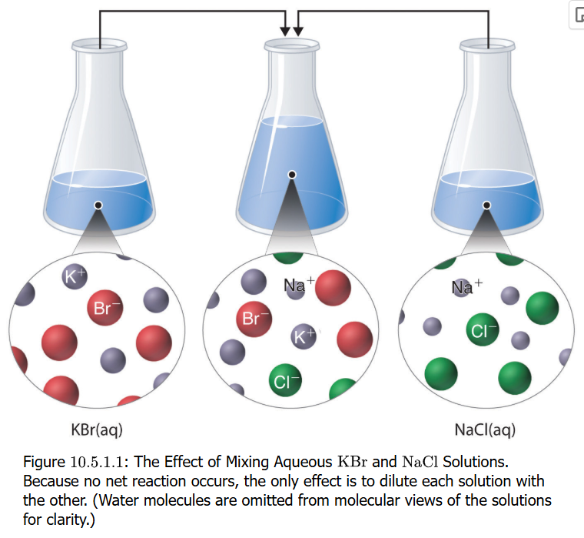
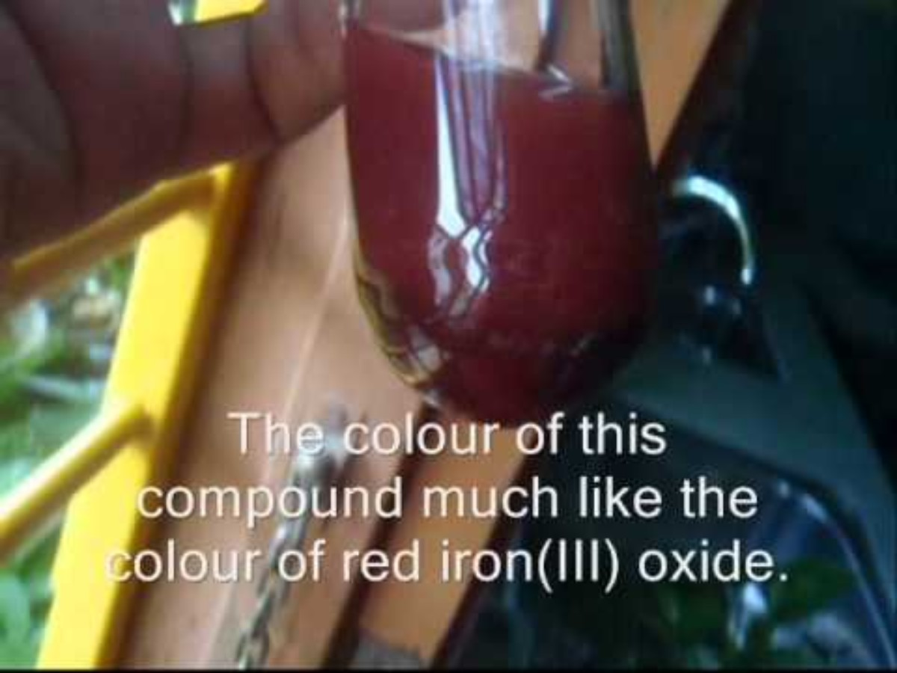
Precipitation Reactions
AC + BD → AD (s) + BC
Precipitations are double displacement reactions with one of products being insoluble
AgNO₃ (aq) + K₂Cr₂O₇ (aq) → Ag₂Cr₂O₇ (s) + KNO₃ (aq)
This is an unbalanced equation (can you balance it?)
Not all mixing of compounds in solutions results in precipitations
Mixing KBr and NaCl solutions results in no reaction except K⁺, Na⁺, Br–, and Cl– ions in solution, all at half original concentrations

Slide 31
Practice: Precipitation Reactions
The 3 steps of the double displacement add a 4th step (actually at the 3rd step) to determine if a product is a precipitate according to solubility rules on your Green Sheet
Sr(OH)₂ (aq) is added to FeCl₂ (aq)
Exchange ions
Sr(OH)₂ (aq) + FeCl₂ (aq) → SrCl + Fe(OH)
Check exchanged ion charges, fix subscripts
Sr(OH)₂ (aq) + FeCl₂ (aq) → SrCl₂ + Fe(OH)₂
Both metals are 2+ ions, both anions 1–
Check solubility (precipitate) and note the phases
Sr(OH)₂ (aq) + FeCl₂ (aq) → SrCl₂ (aq) + Fe(OH)₂ (s)
Metal hydroxides like Fe are insoluble
Balance by finding coefficients
Sr(OH)₂ (aq) + FeCl₂ (aq) → SrCl₂ (aq) + Fe(OH)₂ (s)
Balancing not needed

Slide 32
Practice: Precipitation Reactions
K₃PO₄ solid added to mercury(II) perchlorate, Hg(ClO₄)₂ (aq)
Exchange ions
K₃PO₄ (aq) + Hg(ClO₄)₂ (aq) → K(ClO₄) + Hg(PO₄)
Check exchanged ion charges, fix subscripts
K₃PO₄ (aq) + Hg(ClO₄)₂ (aq) → KClO₄ + Hg₃(PO₄)₂
K⁺ matches ClO₄–, 3 Hg²⁺ needed for 2 PO₄³⁻
Check solubility (precipitate) and note the phases
K₃PO₄ (aq) + Hg(ClO₄)₂ (aq) → KClO₄ (aq) + Hg₃(PO₄)₂ (s)
Chlorates are soluble, phosphates of mercury are not
Balance by finding coefficients
2 K₃PO₄ (aq) + 3 Hg(ClO₄)₂ (aq) → 6 KClO₄ (aq) + Hg₃(PO₄)₂ (s)
Start with add 3 K to product side, then 3 Hg to reactant side; then see that 3 x 2 = 6 perchlorates are on reactant side, so put 6 in front of KClO₄; also need 2 PO₄ groups, so put 2 in front of K₃PO₄, verify that there are now 2 x 3 = 6 K on reactants and you see 6 x 1 = 6 K on products. DONE!

Slide 33
Practice: Precipitation Reactions
Solid sodium fluoride added to aqueous solution of ammonium formate
Exchange ions
NaF (aq) + NH₄OOCH (aq) → Na(OOCH) + (NH₄)F
Check exchanged ion charges, fix subscripts
NaF (aq) + NH₄OOCH (aq) → NaOOCH + NH₄F
All ions found to be 1+ or 1–
Check solubility (precipitate) and note the phases
NaF (aq) + NH₄OOCH (aq) → NaOOCH (aq) + NH₄F (aq)
Everything soluble, no precipitate
Balance by finding coefficients
NaF (aq) + NH₄OOCH (aq) → NaOOCH (aq) + NH₄F (aq)
No balancing was required in this step either

Slide 34
Practice: Precipitation Reactions
Mix aqueous solutions of calcium bromide and cesium carbonate
Exchange ions
CaBr₂ (aq) + Cs₂CO₃ (aq) → Ca(CO₃) + CsBr
Check exchanged ion charges, fix subscripts
CaBr₂ (aq) + Cs₂CO₃ (aq) → CaCO₃ + CsBr
The exchange actually matched +2 with -2, and +1 with -1
Check solubility (precipitate) and note the phases
CaBr₂ (aq) + Cs₂CO₃ (aq) → CaCO₃ (s) + CsBr (aq)
Carbonates are insoluble for Ca²⁺, bromides are soluble for Cs⁺
Balance by finding coefficients
CaBr₂ (aq) + Cs₂CO₃ (aq) → CaCO₃ (s) + 2 CsBr (aq)
Inspection shows Ca and CO₃ are balanced; add 2 to CsBr to balance Cs atom. The addition caused a balance of Br to the left; DONE

Slide 35
Acid-Base Neutralization
Acids react with bases to neutralize each other with the products being a salt and water
NaOH (aq) + HCl (aq) → NaCl (aq) + H₂O (l)
2 NaOH (aq) + H₂SO₄ (aq) → Na₂SO₄ (aq) + 2 H₂O (l)
Neutralize nitric acid with calcium hydroxide
Exchange ions
Ca(OH)₂ (aq) + HNO₃ (aq) → Ca(NO₃) (aq) + H₂O (l)
Check exchanged ion charges for product, fix subscripts
Ca(OH)₂ (aq) + HNO₃ (aq) → Ca(NO₃)₂ (aq) + H₂O (l)
Balance by finding coefficients
Ca(OH)₂ (aq) + 2 HNO₃ (aq) → Ca(NO₃)₂ (aq) + 2 H₂O (l)
Ca has one on both sides; next check H atom: 2 on right, 2 x 1 + 1 = 3 on left, so try putting 2 for HNO₃ making it 4 H atoms on left, so put 2 in front of H₂O on right; check N atoms: 2 on left and 2 on right (good); check O atoms: 2 x 1 + 3 x 2 = 8 on left, same check is good on right, DONE!

Slide 36
Practice: Acid-Base Neutralization
Placeholder here

Slide 37
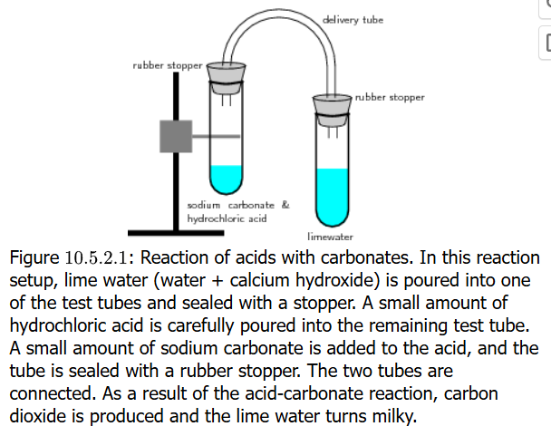
Gas-Evolving Reactions
Reactions of acids with carbonate salts usually produce a gas like carbon dioxide
2 HNO₃ (aq) + Na₂CO₃ (aq) → 2 NaNO₃ (aq) + CO₂ (g) + H₂O (l)
H₂SO₄ (aq) + CaCO₃ (aq) → CaSO₄ (aq) + CO₂ (g) + H₂O (l)
2 HCl (aq) + CaCO₃ (aq) → CaCl₂ (aq) + CO₂ (g) + H₂O (l)
In the figure on the right, CO₂ created or released by the addition of the carbonate salt (Na₂CO₃) to dilute acid (HCl) in the tube on the stand (left) leaves the tube through the stopper into tubing that connects to a stoppered tube on the right which contains calcium hydroxide [Ca(OH)₂] on the right. Because CaCO₃ is insoluble, a precipitate forms making the solution milky

Slide 38
Gas-Evolving Reactions
Reactant Type | Intermediate Product | Evolved Gas | Example
sulfide | none | H₂S | 2 HCl (aq) + K₂S → H₂S (g) + 2 KCl (aq)
carbonates, bicarbonates | H₂CO₃ | CO₂ | 2 HCl (aq) + K₂CO₃ → H₂O (l) + CO₂ (g) + 2 KCl (aq)
sulfites, bisulfites | H₂SO₃ | SO₂ | 2 HCl (aq) + K₂SO₄ → H₂O (l) + SO₂ (g) + 2 KCl (aq)
ammonia | NH₄OH | NH₃ | NH₄Cl (aq) + KOH → H₂O (l) + NH₃ (g) + 2 KCl (aq)

Slide 39
Gas-Evolving REDOX Reactions
Reactions of acids with metals also generate a gas:
2 HCl (aq) + Zn (s) → H₂ (g) + ZnCl₂ (aq)
This reaction is really a case of oxidation of the metal, and the reduction of protons to form hydrogen gas
Oxidation is when electrons are taken from an element/atom in a reaction (the redox reaction)
Reduction is when electrons are gained by an element/atom in a reaction (the redox reaction)
The two half-reactions
Zn → Zn²⁺ + 2 e– (oxidation)
2 H⁺ + 2 e– → H₂ (reduction)

Slide 40
Writing Equations for Reactions
For the precipitation reaction of barium chloride mixed with sodium sulfate, it is written to illustrate the essence of the reaction. Call this the complete chemical equation
BaCl₂ (aq) + Na₂SO₄ (aq) → BaSO₄ (s) + NaCl (aq)
But what really happens when compound is dissolved in an aqueous solution is that compounds do not exist in this way but are dissolved ions in solution. Call this the complete ionic equation
Ba²⁺ (aq) + 2 Cl– (aq) + 2 Na⁺ (aq) + SO₄^{2–} (aq) ➔ BaSO₄ (s) + 2 Cl– (aq) + 2 Na⁺ (aq)

Slide 41
Writing Equations for Reactions
Ba²⁺ (aq) + 2 Cl– (aq) + 2 Na⁺ (aq) + SO₄^{2–} (aq) ➔ BaSO₄ (s) + 2 Cl– (aq) + 2 Na⁺ (aq)
On the reactant and product sides, ions (Ba²⁺, Cl–, Na⁺, SO₄^{2–}) are present in dissolved form which you have determined to be the true form
Stoichiometry is preserved: BaCl₂ was solid, and it yielded Ba²⁺ and 2 Cl–. The same for Na₂SO₄: SO₄^{2–} and 2 Na⁺
Ba²⁺ and SO₄^{2–} are not shown on the product side as ions because they form a solid (precipitate) which is BaSO₄
Na⁺ and Cl– do not participate in the reaction and in effect cancel each other on both sides of the chemical equation or reaction arrow: these are spectator ions
The reaction can instead be written as a net ionic equation as follows, removing the spectator ions:
Ba²⁺ (aq) + SO₄^{2–} (aq) ➔ BaSO₄ (s)

Slide 42
Writing Equations for Reactions
On the reactant
Ba²⁺ (aq) + 2 Cl– (aq) + 2 Na⁺ (aq) + SO₄^{2–} (aq) ➔ BaSO₄ (s) + 2 Cl– (aq) + 2 Na⁺ (aq)
On the reactant and product sides, ions (Ba²⁺, Cl–, Na⁺, SO₄^{2–}) are present in dissolved form which you have determined to be the true form
Stoichiometry is preserved: BaCl₂ was solid, and it yielded Ba²⁺ and 2 Cl–. The same for Na₂SO₄: SO₄^{2–} and 2 Na⁺
Ba²⁺ and SO₄^{2–} are not shown on the product side as ions because they form a solid (precipitate) which is BaSO₄
Na⁺ and Cl– do not participate in the reaction and in effect cancel each other on both sides of the chemical equation or reaction arrow: these are spectator ions
The reaction can instead be written as a net ionic equation as follows, removing the spectator ions:
Ba²⁺ (aq) + SO₄^{2–} (aq) ➔ BaSO₄ (s)

Slide 43
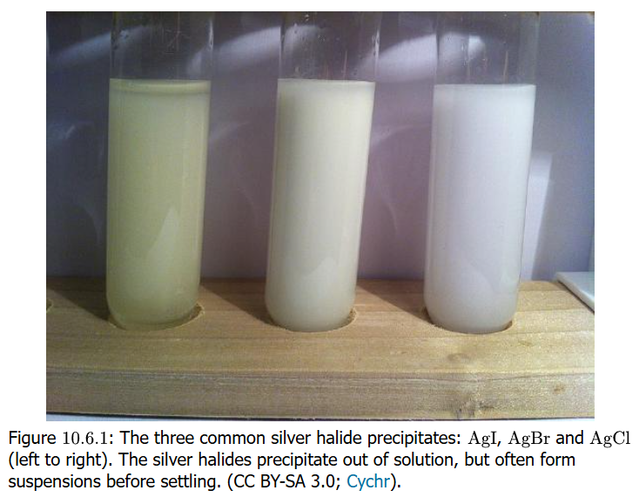

Writing Equations for Reactions

Slide 44
Oxidation States

Slide 45
Oxidation States & Redox Reactions

Slide 46
Half Reactions

Slide 47
Activity Series

